Slide 1
Excel capstone project February 22
Shubham Gupta

Slide 2
DATASET of the Indian state Madhya Pradesh…….
This is the dataset of Indian state Madhya Pradesh based on total vegetable and fruits cultivation in different districts, here I have taken only 24 district out of 52 for analysis.
The dataset contains historical data of total production generated in urban and rural areas by year, category, region & map of Madhya Pradesh.
It helps us to analyze the data of cultivation & production of fruits & vegetables in 5 region of Madhya Pradesh(2011-13).
In this analysis we have taken the total contribution of ‘Bhopal city’ the capital of MP (2011-13) separately.
Source of data- https://data.world/thatzprem/agriculture-india-mp

Slide 3
PROBLEM STATEMENT overview……….
District wise: total vegetables production.
District wise: total fruits production.
How much land used for agriculture(in hectares) ?
Region wise: total production of vegetables.
Region wise: total fruits production.
Province wise: vegetable production using dynamic map of Madhya Pradesh.
How much average production of f & v year wise ?
How much the capital city of Madhya Pradesh contributing production category wise ?
Which cities are the top 6 high vegetable producing ?
Area wise: what are the top best 6 fruits producing areas of M.P ?
How much Madhya Pradesh contributing (%) the total production in India in terms of fruits & vegetables ?

Slide 4
Summary of this project…………
The purpose of this project is to analyze that how much M.P contributing in Indian economy.
The growth of cultivation & production in most popular cities are increasing and rural areas also contributing high, farmers are going to use automatic equipment's to increasing farming which is fast & efficient.
The climate of M.P is suitable for various vegetables & Fruits whole year by which production increasing year by year.
The outcome helps to know that M.P generating high profit with high production year by year.
Please check the presentation on- https://youtu.be/tiTccsETWDk

Slide 5
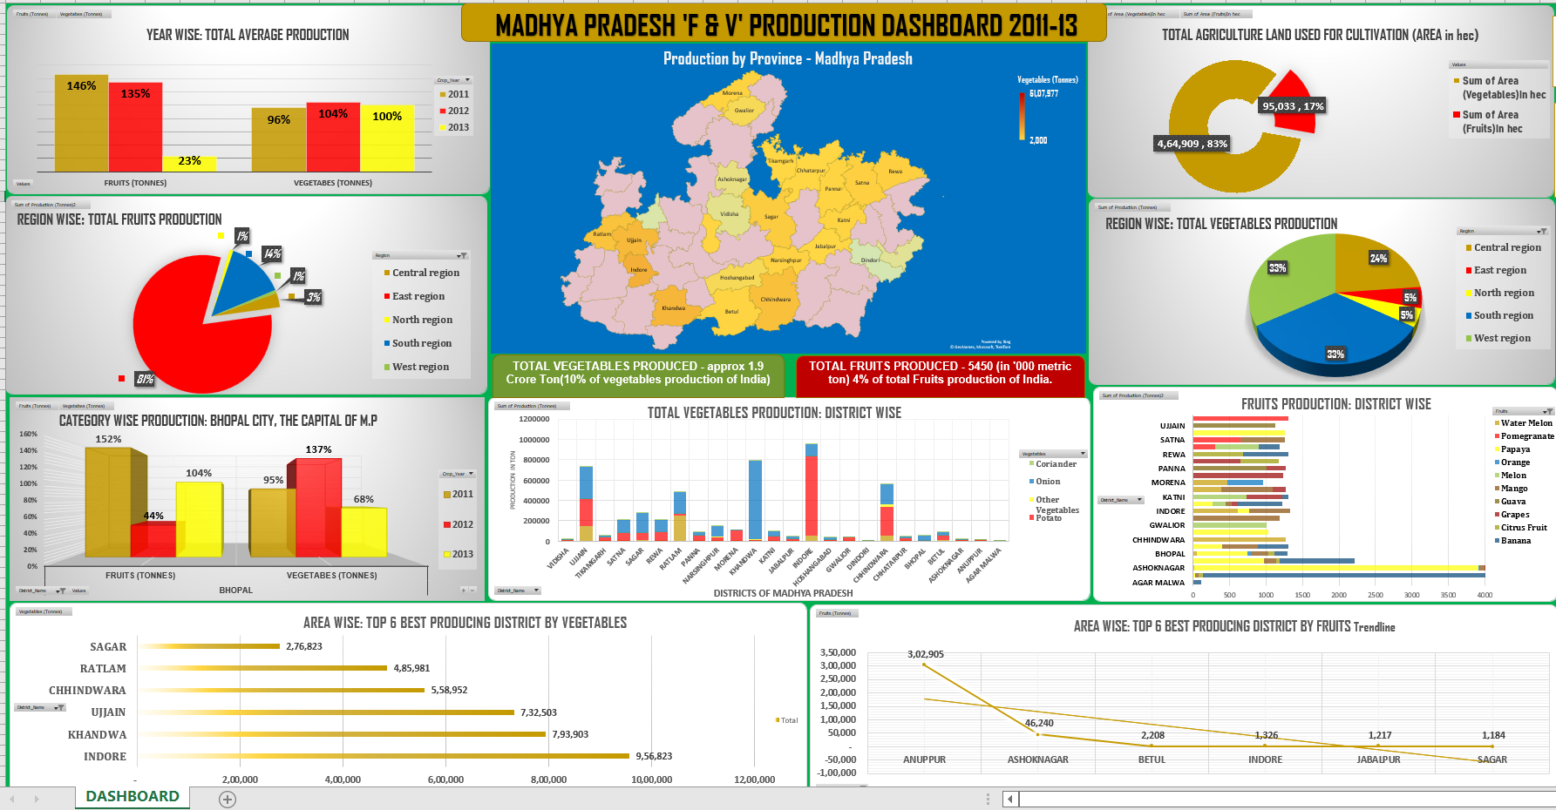

Slide 6
Conclusion of study………..
After the analysis his data we can see that the total fruits production generated from all region is 3,75,608 (metric ton) in which south & west region contributing on high.
M.P contributing 10%-(3rd) & 4%-(6th) of total vegetable & fruits production in Indian economy. This accounted for about 369 billion Indian rupees.
The total production generated from vegetables from all 24 districts is 51,07,977 (metric ton) in which Indore distt is contributing high which is 9,56,823 (mt) then Khandwa dist is on 2nd & Ujjain is on 3rd position.
Here we have compare the top best cities in which 2011 is on highest in terms of fruits & 2012 in vegetables & 2013 is lowest in fruits production & moderate in vegetables.
In onion Khandwa dist having high production & in banana & papaya Ashok Nagar dist having highest contribution.
East region is most profitable in terms of fruits cultivation & production.
We can classify this data according to different district, region, year etc. from dashboard.

Slide 7
Thank you

